Slide 1

DATA
VISUALIZATION
with Maryam Zaringhalam
and Francisco Guerrero
facilitated by Liz Neeley
Notes:
"explore expectations and norms in the worlds of print and audio journalism, including what sources can ask for and should do before accepting interview requests"

Slide 2







experiment
Modified from work in prep with Francisco Guerrero
analyze
report
share
ideate
SCIENCE
communication
Notes:
Reconfiguring our mental models of communication – this is a traditional (outmoded) linear representation

Slide 3






report
ideate
analyze
experiment
Notes:
And visualizations support each one of these

Slide 4
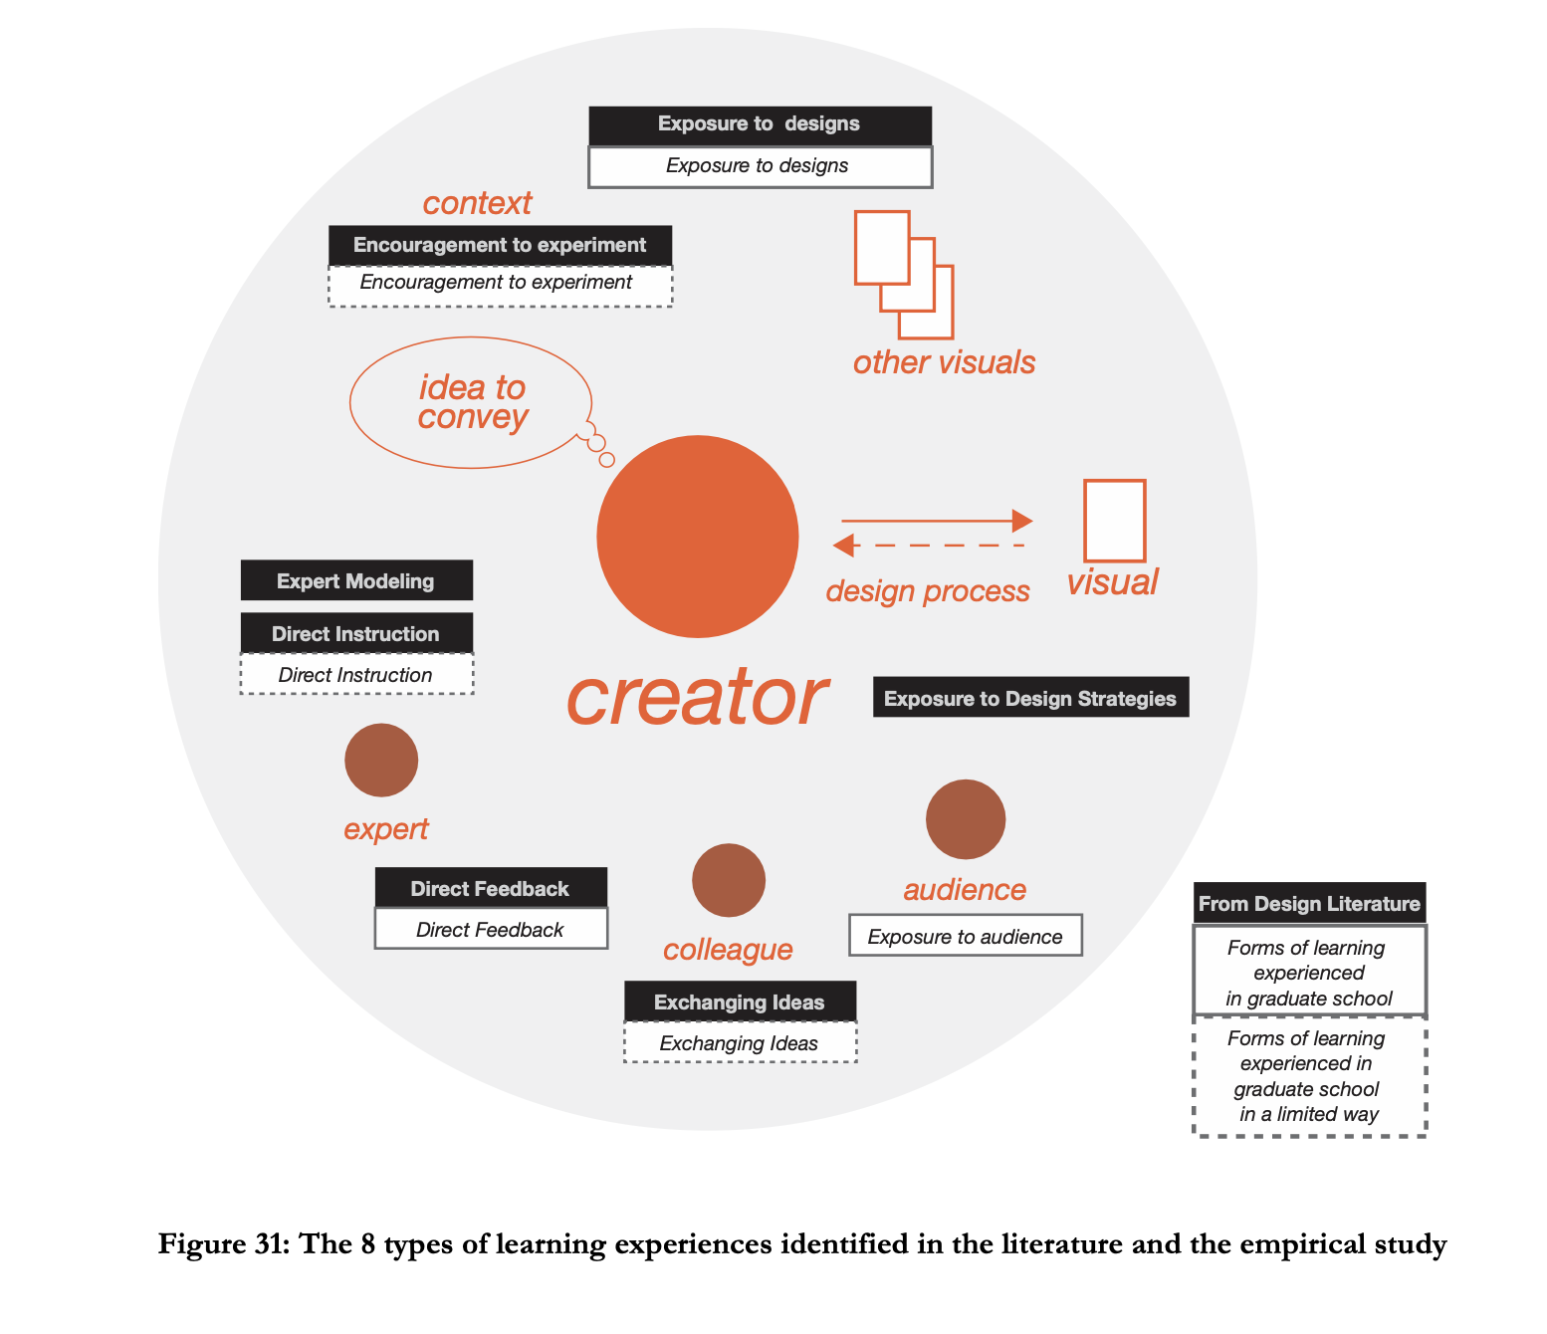
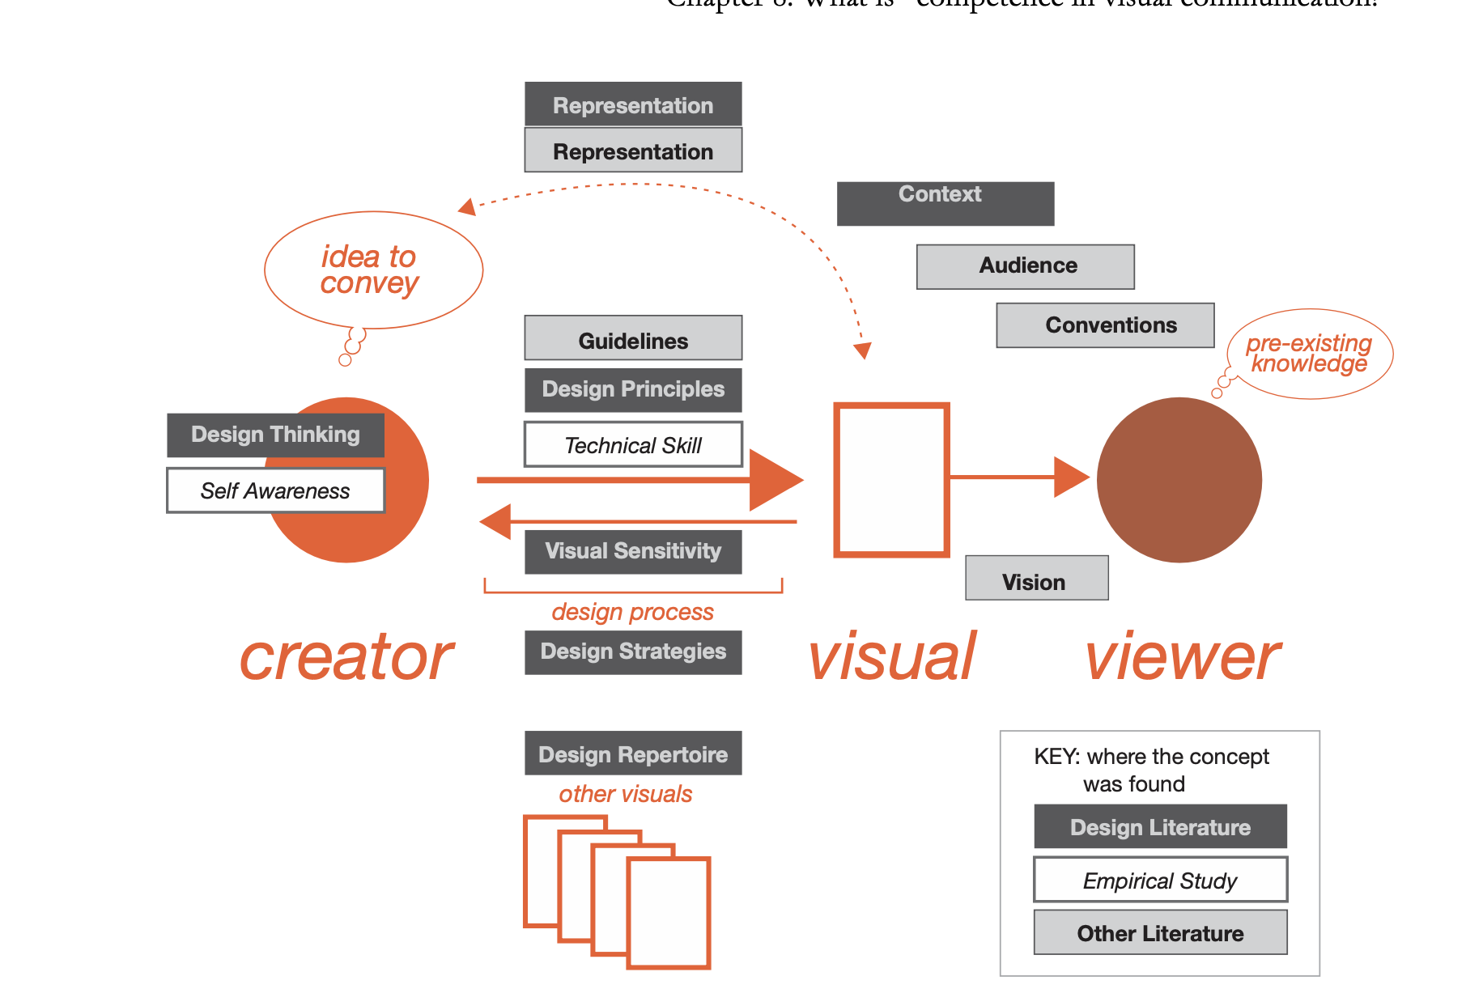
Notes:
Images from Ostegren I’d like to translate

Slide 5
“The usefulness of a graph can be evaluated only in the context of the type of data, the questions the designer wants the readers to answer, and the nature of the audience.”
— Stephen M. Kosslyn, Graph Design for the Eye and Mind

Slide 6
FORM
follows
FUNCTION

Slide 7
FUNCTION
What are you trying to achieve through this visualization?
What do you want your user to do with this information?

Slide 8
PREATTENTIVE PROCESSING

Slide 9
color

Slide 10


THE CLEVELAND-McGILL SCALE
more generic judgements
more accurate
judgements
color hue
shading
volume
area
angle
direction
length
position along a common scale
adapted from Cleveland & McGill Science 1985

Slide 11
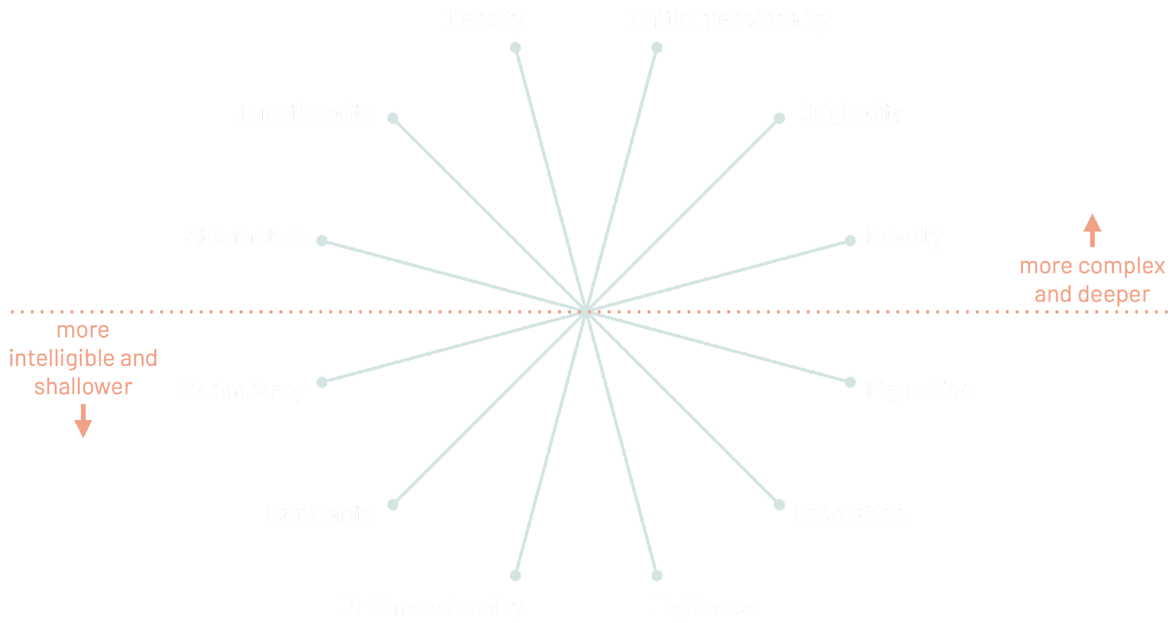
adapted from Alberto Cairo's The Functional Art

Slide 12
FORM
DESIGN
FUNCTION

Slide 13
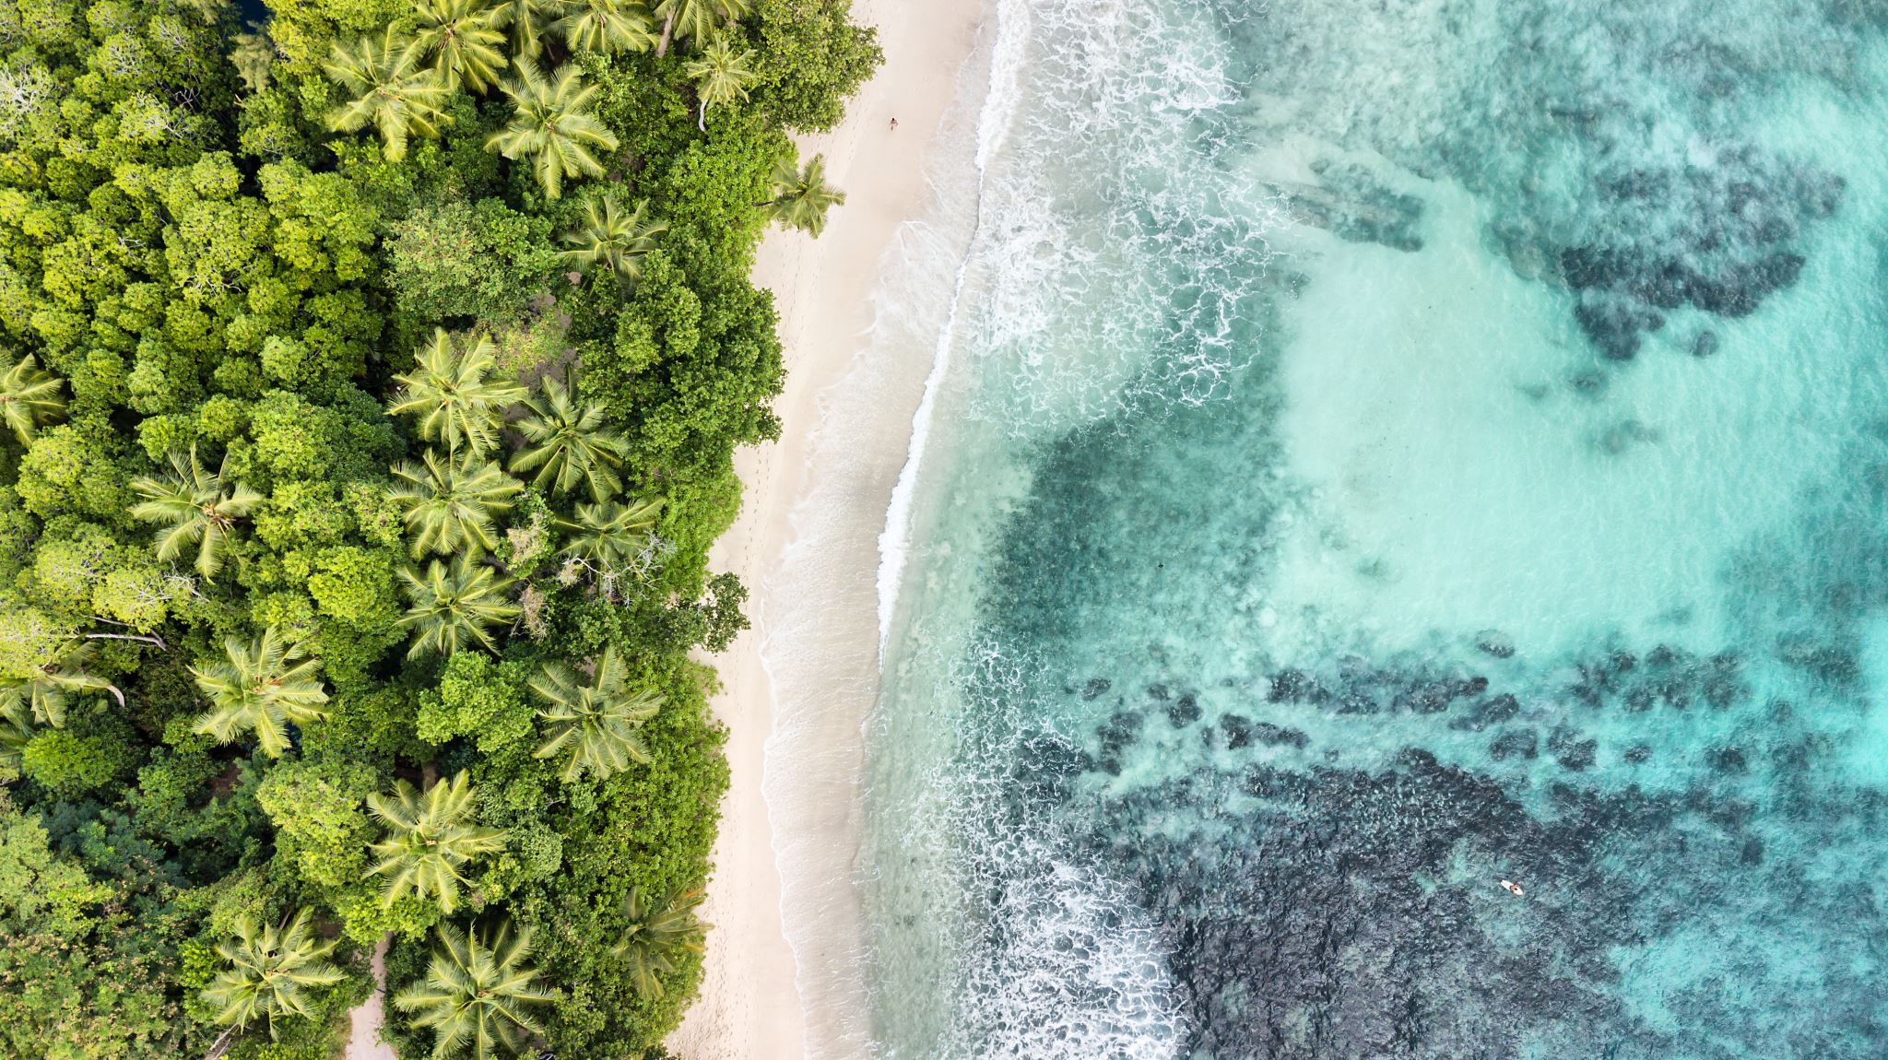

Slide 14
RELATIVE
POSITIONS

Slide 15
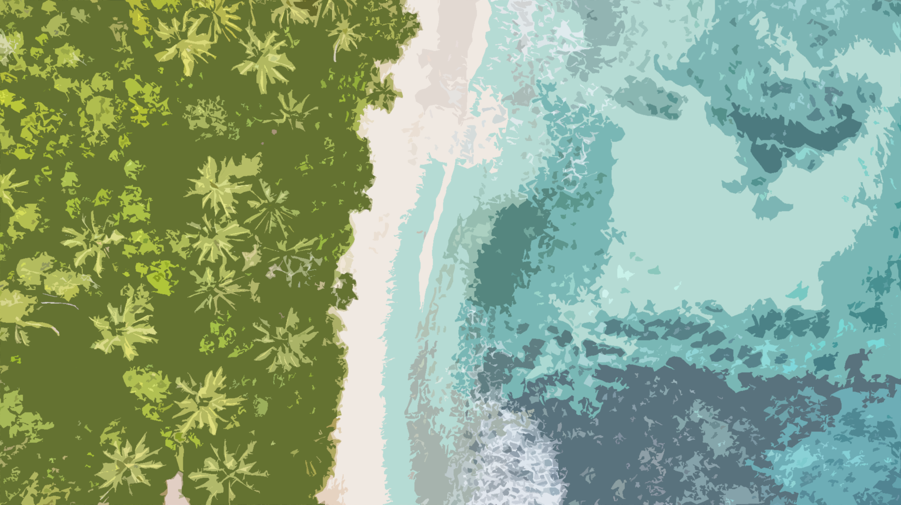


The Sea of Mysteries
DESIGNER
USER
DATA
VISUALIZATION
The
Shoreline
of
Wonder
The Island of Knowledge

Slide 16
The Sea of Mysteries
DESIGNER
USER
DATA
VISUALIZATION
The
Shoreline
of
Wonder
The Island of Knowledge

Slide 17

The Sea of Mysteries
DESIGNER
USER
Mental imagery
Graphical Perception
ENCODING
DATA
VISUALIZATION
DECODING
The Shoreline
of Wonder
The Island of Knowledge

Slide 18
“The abundance of evidence that mental imagery can be depictive [i.e., picture-like] while still involving semantic information [i.e., language-like] is now overwhelming.”
— Joel Pearson, The human imagination: the cognitive neuroscience of visual mental imagery.
Nature Reviews | 2019 | https://doi.org/10.1038/ s41583-019-0202-9

Slide 26
TEXT FACE – Barlow
COLOR PALETTE HEX CODES
Darkest - #0E313A
Dark - #234F5B
Medium - #3A707F
Light - #9ECCC6
Lightest - #CFE5E2
Pink - #FF9E80
Red - #F75848

